Slide 1
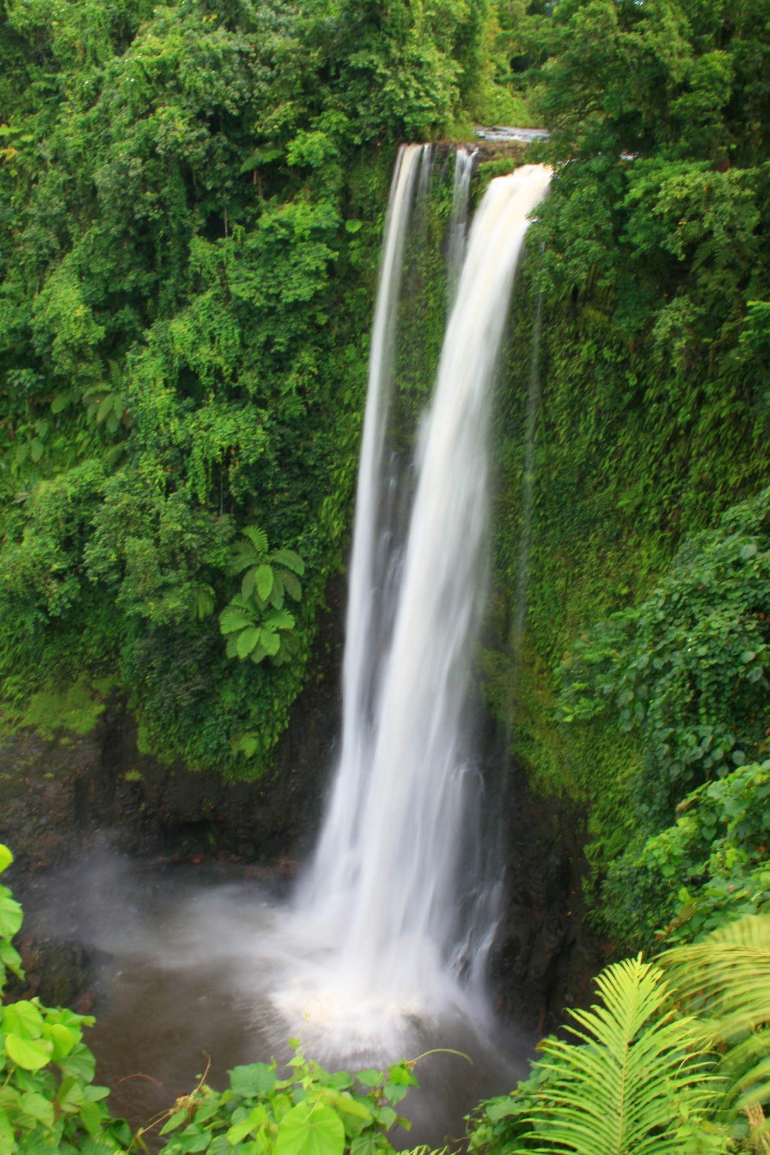
3rd Sunday of Easter
The breakfast on the shore
There are many different ways to show people that we
Love them;a kiss, a smile, an act of kindness. Jesus appeared to his disciples and prepared a meal to share
with them as a sign of his love and friendship.

Slide 2
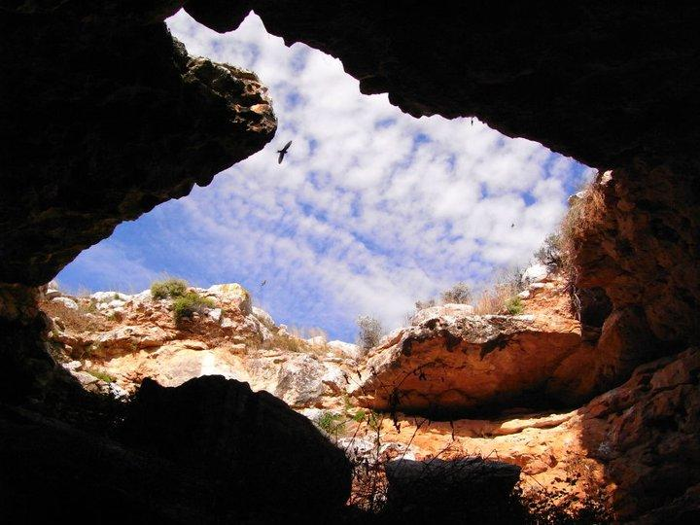

OPENING PRAYER
Dear Gracious God,
In whom we know the power of your love which gives us strenth
You stand among us us in our shadows of time
Help us to reconise this and share your spirit today by showing your love in all that we say and do
AMEN

Slide 3

Gospel Acclamation
Alleluia Alleluia Praise the lord
Alleluia Alleluia praise the lord
As we listen to the story
Let us praise us for his glory
Alleluia Alleluia praise the lord

Slide 4
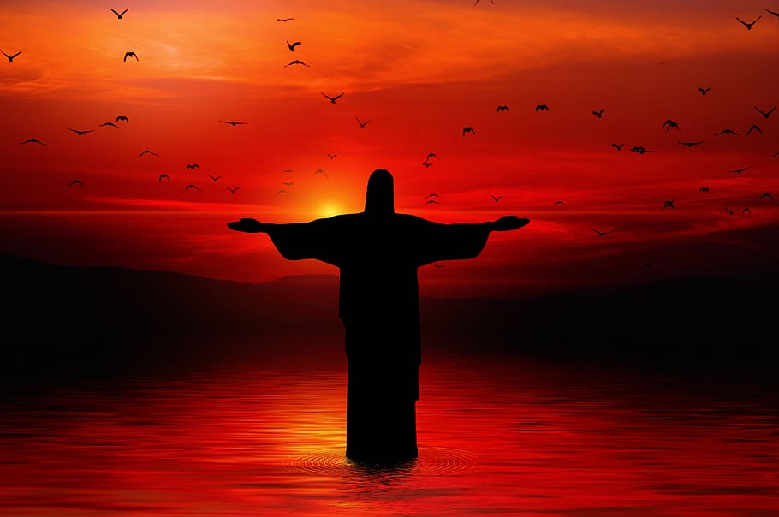
Gospel Reading
John 21:1-17
Peter and some of the disciples had been fishing all night but had caught nothing. As daylight dawned, they noticed a man on the shore who called out to them, ‘Have you caught anything?’ As they shook their heads, the stranger said, ‘Try once more over there!’ They threw their nets back into the water and caught so many fish that their nets were ready to burst. At that moment Peter recognised Jesus, and jumping into the water, he swam to meet him. On the beach, Jesus made a fire and was cooking breakfast for Peter and his friends. After they had eaten ,Jesus turned to Peter and asked “ Do you love me ?” “yes Lord you know that I love you ,”Peter said Jesus asked Peter this question three more times and after, Jesus told Peter about the work he wanted him to do .

Slide 5
Gospel Acclamation
Alleluia Alleluia Praise the lord
Alleluia Alleluia praise the lord
As we listen to the story
Let us praise us for his glory
Alleluia Alleluia praise the lord

Slide 6

REFLECTION
I wonder how the disciples were feeling after Jesus had died and they were all alone?
What was Jesus doing on the shore?
What made Peter recognise Jesus that day?
When do we share a special meal with Jesus?
When they had finished eating what did Jesus ask Peter?

Slide 7
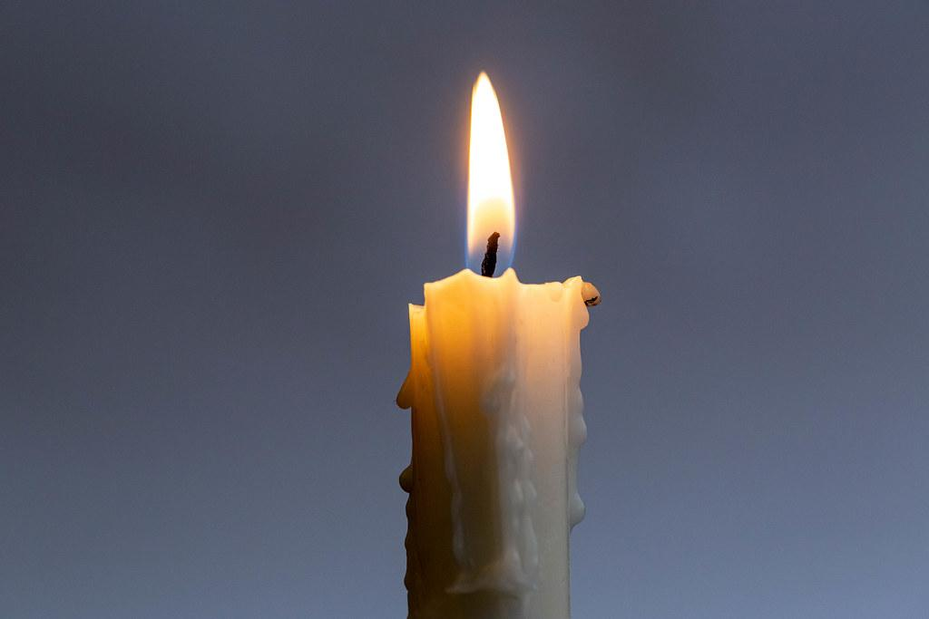
Let us pray for the people of Ukraine Give them the courage of your spirit Lord hear us Lord graciously hear us
Let us pray for the sick in our community and parishh Give them the strength of your spirit Lord hear us Lord graciously hear us
We pray for world leaders that they have the courage to lead with honesty and integrity Lord hear us Lord graciously hear us Let us pray the prayer that the Jesus taught us OUR FATHER

Slide 8

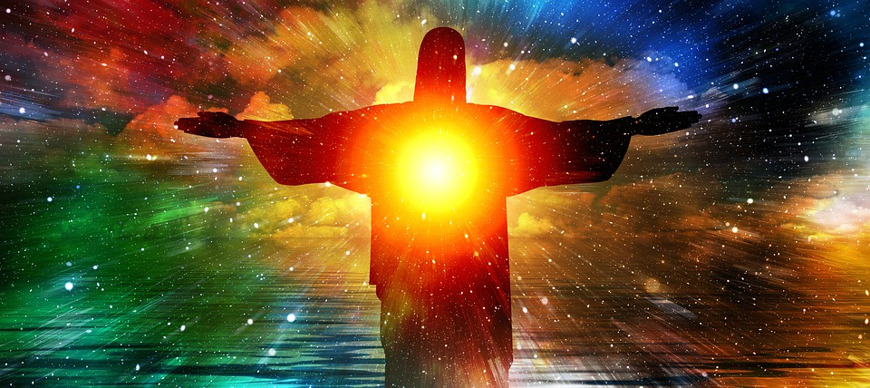
HYMN
Share the light of Jesus Share the light that shows the way Share the light of Jesus Share God’s spirit today Share God’s spirit
Share the word…
Share the smile…
Share the love

Slide 9
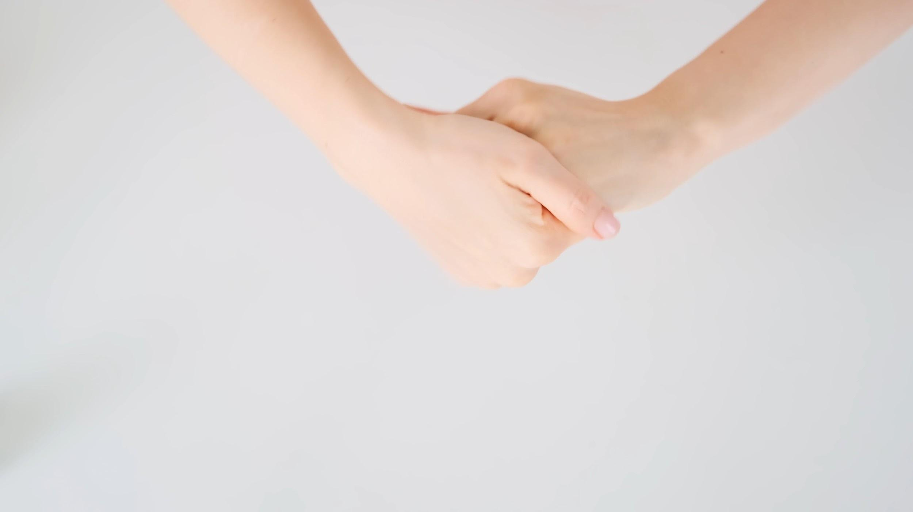
Closing prayer
Lord Jesus
Help us to recognise you
In the world around us
And to show how much we love you
By our words and actions
AMEN

Slide 10
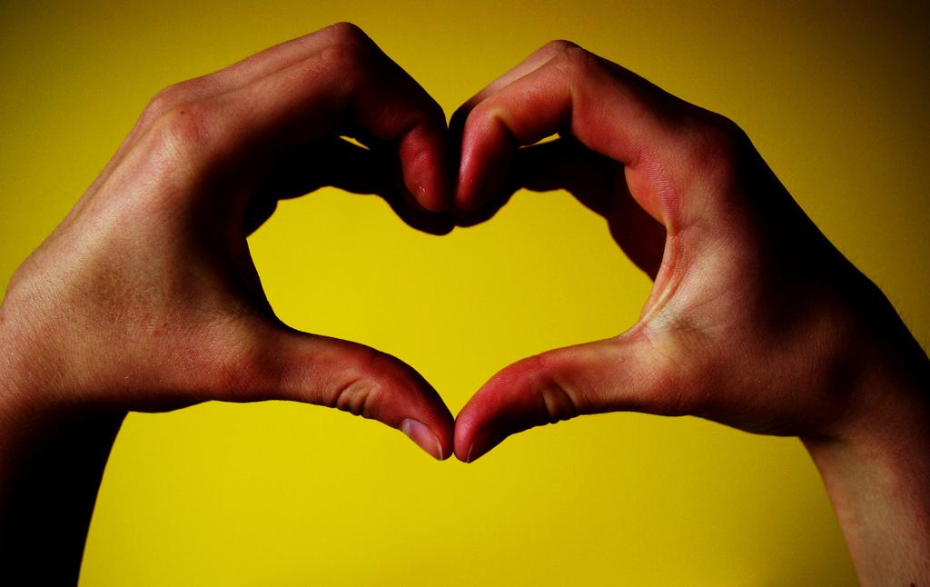
Go forth
Jesus’ spirit is with you go forth and show his love today with kind hands kind words and kind actions.

