Slide 2
Our Lord Jesus Christ King of the Universe
Welcome: Today is the feast of Christ the King. Jesus didn’t live in a palace or wear a gold crown, so what kind of king is he? Let’s find out today.

Slide 3
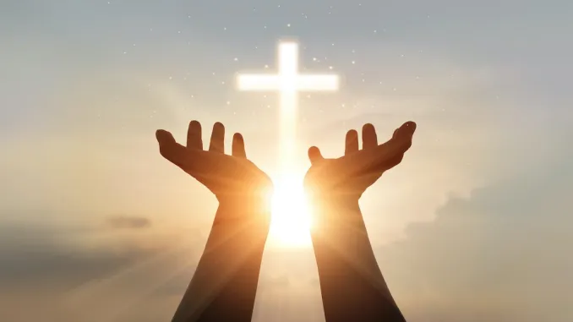
Opening Prayer
God of all, you sent your Son to show us how to live. Help us to listen to the truth and to follow Jesus’ example in our lives. Amen.

Slide 4
Gospel Acclamation
Alleluia, Alleluia, Praise the Lord
Alleluia, Alleluia, Praise the Lord
As we listen to the Story
Let us praise him for his glory
Alleluia, Alleluia Praise the Lord

Slide 5
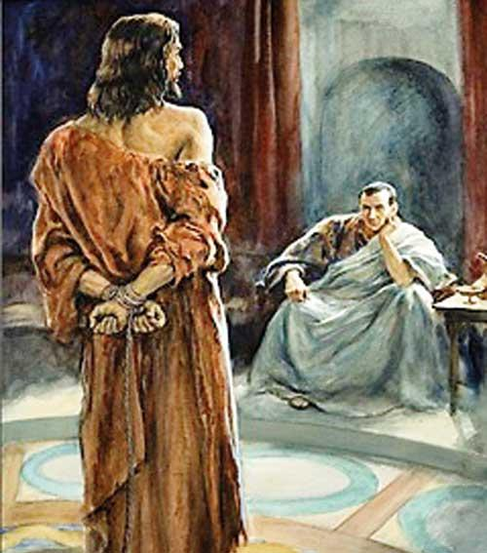
A reading from the Gospel according to John 18:33-37

Slide 6
Pilate went back into the palace and called Jesus. “Are you the King of the Jews?” he asked him.
Jesus answered, “Does this question come from you or have others told you about me?”
Pilate replied, “Do you think I am a Jew? It was your own people and the chief priests who handed you over to me. What have you done?”
Jesus said, “My kingdom does not belong to this world; if my kingdom belonged to this world, my followers would fight to keep me from being handed over to the Jewish authorities. No, my kingdom does not belong here!”
So Pilate asked him, “Are you a king, then?”
Jesus answered, “You say that I am a king. I was born and came into the world for this one purpose, to speak about the truth. Whoever belongs to the truth listens to me.”

Slide 7
Gospel Acclamation
Alleluia, Alleluia, Praise the Lord
Alleluia, Alleluia, Praise the Lord
As we listen to the Story
Let us praise him for his glory
Alleluia, Alleluia Praise the Lord

Slide 8
Reflection
What do you remember from today’s reading?
Pilate asks Jesus if he is king of the Jews. Jesus answers that his kingdom is not of this world. What do you think he means?
Jesus’ kingdom isn’t on earth. We can’t see it. Jesus doesn’t wear a crown or have lots of riches. He doesn’t live in a palace with lots of servants. Jesus was born in a stable and mostly lived a normal life in a carpenter’s family.
We cannot see his kingdom and he doesn’t behave like a normal king. And yet, Jesus is a very special king, because he is the Son of God.

Slide 9
Reflection
Jesus is the Son of God. He came to share the truth of God’s love for all people with us.
But how do we listen to Jesus and what he wants to tell us about? We can listen to Jesus by hearing the Gospel and thinking about what Jesus is showing us in these stories. Also we can listen to Jesus when we take time to sit still and quiet and when we pray.
How will you show that you are listening to Jesus this week?

Slide 10
Intercessions
We try to listen to Jesus as we pray together:
We pray for world leaders: that they may really listen to their people and follow Jesus’ example of love and help for all who are in need. Lord, in your mercy…
We pray for all people around the world, especially those who are poor: that everyone may have the chance to speak up about what is important to them and be listened to. Lord, in your mercy…
We pray for our parish, family and friends: that we may listen to others and to Jesus and do all that we can to change our lives for the better. Lord, in your mercy…

Slide 11
Closing Prayer
Christ our King, help us to be like you, to listen to your truth and to see that all people are important, no matter who they are or where they come from. Amen.

Slide 12
Commissioning
Go forth: Share all that you have heard and thought about today with the people at home and listen carefully to others all week. Remind them to try to listen to Jesus every day.

