Slide 1
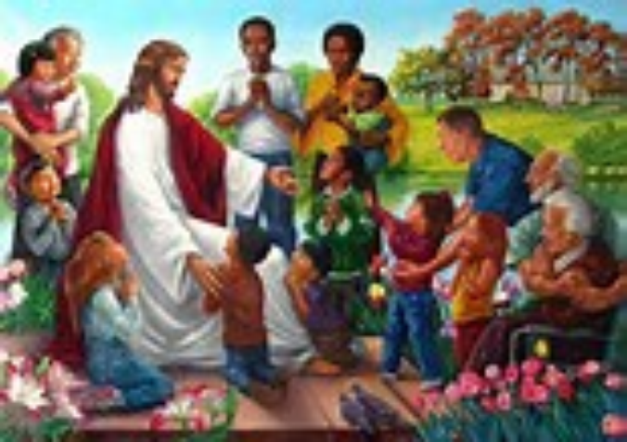
27th Sunday of Ordinary Time Welcome: Today we are going to hear how special and important children were to Jesus.
.

Slide 2
Opening Prayer
Loving God, your Son Jesus shows us that all people, including little children, are important and loved by you. Help us to follow his example, and care for all people and our world.
Amen

Slide 3
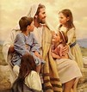
Hymn – Jesus’ Love Is Very Wonderful.

Slide 4
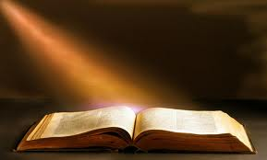
Gospel acclamation
Alleluia, Alleluia, Praise the Lord
Alleluia, Alleluia, Praise the Lord
As we listen to the Story
Let us praise him for his glory
Alleluia, Alleluia Praise the Lord.

Slide 5
Gospel: Mark 10: 13-16

Slide 6
Time to reflect……
What do you remember from that reading?
Why do you think that the disciples did this?
What did Jesus say to the disciples?

Slide 7
We know that Jesus welcomed children and so we have the courage to pray together:
We pray for all people who are poor in our world: that God may give them hope and love. Lord, in your mercy…
We pray for our parish, families and friends: that we may be moved to care for creation, so everyone can enjoy God’s gifts. Lord, in your mercy…

Slide 8
Closing Prayer
God of love, you teach us to see that the world is good. Help us to care for creation and to love our sisters and brothers. Amen.
Amen

Slide 9
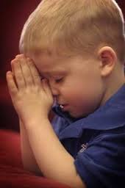
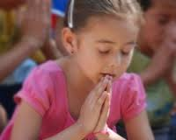
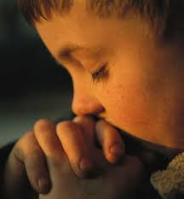
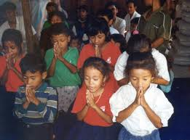
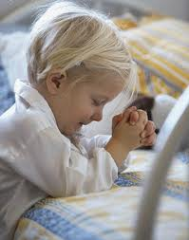
Go Forth…..
Think about finding time for Jesus this week…..

