Slide 1
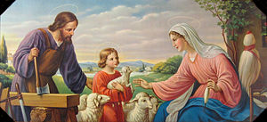
4th Sunday of Ordinary Time Welcome: In today’s gospel we hear how the people of Jesus’ own town, Nazareth, became very angry with him. Listen to find out why…
.

Slide 2
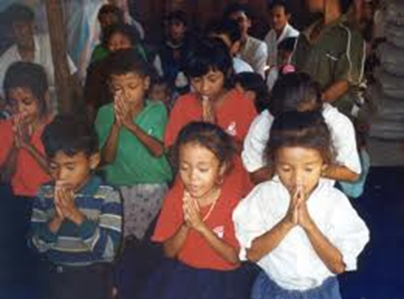
Opening Prayer
Saving God, you sent your Son to show us how to live our lives.
Help us to do all that we can to follow this example, and open our hearts to see that even the most ordinary-seeming person is capable of doing special things. We ask this through Christ our Lord, Amen.

Slide 3
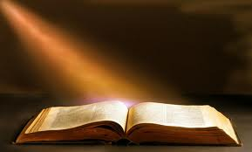
Gospel acclamation
Alleluia, Alleluia, Praise the Lord
Alleluia, Alleluia, Praise the Lord
As we listen to the Story
Let us praise him for his glory
Alleluia, Alleluia Praise the Lord.

Slide 4
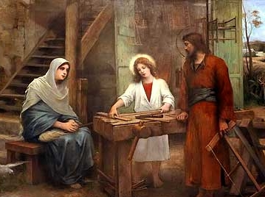
Gospel: Luke 4:21-30

Slide 5
Gospel acclamation
Alleluia, Alleluia, Praise the Lord
Alleluia, Alleluia, Praise the Lord
As we listen to the Story
Let us praise him for his glory
Alleluia, Alleluia Praise the Lord.

Slide 6
Time to reflect……
Last week we heard how Jesus was speaking in the synagogue and how he had been sent by God to bring good news to people who are poor. The people were amazed with all that he said to them.
Today’s reading follows straight on from last week’s. But how do the people feel about what Jesus is saying today?
The people do not believe that Jesus is special. They become angry about what he is saying. Why do you think that is?
Jesus was preaching in his home town. This was the place where he had grown up and many of the people knew him. They knew him as an ordinary man, the son of Joseph the carpenter.
Sometimes when we know someone very well, we see their good points and their bad points. Because we know them so well we think of them as ordinary and we no longer see how special they are.
Sometimes the person themselves doesn’t even realise they are doing anything special. They think they are just being quite ordinary.
But all people, no matter how ordinary they seem, are special. And they can all do special things.
Can you think of some ordinary people who have done very special or extraordinary things? Who are they and what did they do?

Slide 7
Intercession
God is always with us, giving us strength and courage to take action and make a difference and so we pray together:
We pray for world leaders: that they may listen to their own people when they speak the truth and take action to make people’s lives better. Lord, in your mercy…
We pray for all people around the world who face injustice: that they may have the strength and courage to stand up for what they believe in and make a change. Lord, in your mercy…
We pray for our parish, families and friends: that we may serve God and do extraordinary things, each in our own way. Lord, in your mercy…

Slide 8
Closing Prayer
God of mercy and truth, open our hearts to the truth of the good news taught to us by your Son, Jesus.
Open our eyes to see that all people are special and strengthen our faith so that we may serve you better, as we try to make a difference to the lives of others.
This we pray in Jesus’ name,
Amen

Slide 9
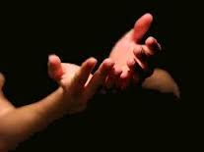
Hymn – If I were a Butterfly!

Slide 10
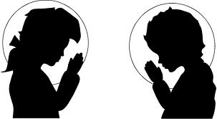
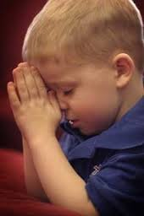
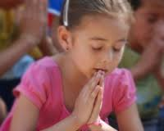
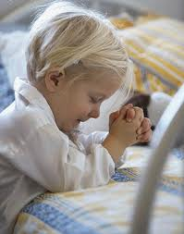
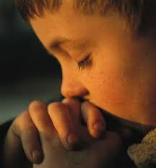
Go Forth…..
Think about how we can pray for the sick….

