Slide 1
TROUBLES
By Olly, Lilly, Evie-Grace and Aubry

Slide 3
troubles
Sometimes we all have troubles, that we worry about and we carry them as a heavy load

Slide 4
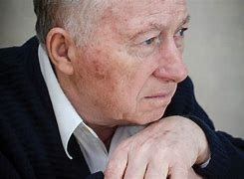
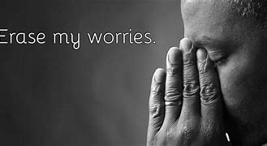

Slide 5
Gospel reading Matthew 6:31-34

Slide 6
questions
Is there anything you are worried about?
Do you think God can help you with your worries?
Can you ask God to help you to talk to someone else about this worry?

Slide 7
I wonder
I wonder, have you got any troubles?
I WONDER HOW YOU COPE?
I WONDER HOW GOD CAN HELP YOU WITH YOUR TROUBLES?

Slide 9
Prayer
Lord I’m blowing bubbles up to you
I’m blowing my troubles up to you
Just like when the bubbles go pop you can help troubles disappear and stop, lord I’m blowing my bubbles up to you
Amen

Slide 10
GOING FORTH
IF THERE IS ANYTHING THAT IS WORRYING US THIS WEEK ASK GOD TO HELP US TALK ABOUT THESE WORRIES WITH SOMEONE ELSE, ESPECIALLY DURING THESE DIFFICULT TIMES.

Slide 11
You can now blow your troubles away with your bubbles .

