Slide 1
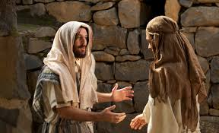
28th Sunday of Ordinary Time Year B Welcome: Today we hear about how Jesus asks a rich young man to sell his nice things and to give all his money to people who are poor. What do you think the rich man did? Let’s find out…

Slide 2
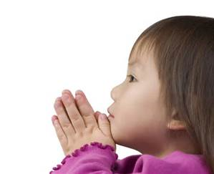
Opening Prayer
God of light, show us how we can answer your call. Inspire us to share all that we have with others, so that all people around the world may live free from poverty.
Amen.

Slide 3
Gospel acclamation
Alleluia, Alleluia, Praise the Lord
Alleluia, Alleluia, Praise the Lord
As we listen to the Story
Let us praise him for his glory
Alleluia, Alleluia Praise the Lord.

Slide 4
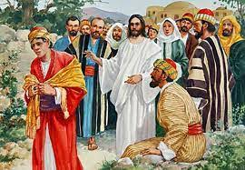
Gospel: Luke 17:11-19 Mark 10:17-30

Slide 5
Gospel acclamation
Alleluia, Alleluia, Praise the Lord
Alleluia, Alleluia, Praise the Lord
As we listen to the Story
Let us praise him for his glory
Alleluia, Alleluia Praise the Lord.

Slide 6
Time to reflect……
Gospel reflection: What do you remember from today’s reading?
The rich man asks Jesus what he must do to have eternal life. What does Jesus say?
Jesus asked the man to sell his nice things and to give all his money to people who are poor. Once he had done this, Jesus said, that the man could follow him.
How did the man feel? Did he sell all his things and give the money to those who needed it? Why do you think he didn’t?
How would you feel if someone came along and said that you had to sell all your favourite toys, or that you had to give them away to someone who didn’t have any?
But this is exactly what Jesus does ask of us. That if we have more than enough, that we share what we have with others. That way all people in the world would be able to have the things that they need.

Slide 7
Intercession.
It is sometimes hard to do what Jesus asks of us, and so we pray together for God’s help:
We pray for world leaders: that they may look for ways to make sure all of their people, especially those who are poor, can have their fair share. Lord, in your mercy…
We pray for people living in poverty: that they may have the chance to share in the gifts that God gave for us all. Lord, in your mercy…
We pray for our parish, our families and our friends: that we may have the strength to answer Jesus’ call, to share what we have, and to help make the world a fairer place for all. Lord, in your mercy…

Slide 8
Closing Prayer
Generous God, we thank you for all the gifts that you have given us.
Teach us to share these gifts with others, so all people may have enough.
Amen

Slide 9
Go forth….
Remember to thank God in your prayers
Share all that you have heard and thought about with the people at home during the week.
Share what you have with others.

